Slide 1
4770 Final Project:
A data comparison of Free vs Paid games
Team Members: Damien Teston, Deep Dabhi, Andres Gal’lino

Slide 2
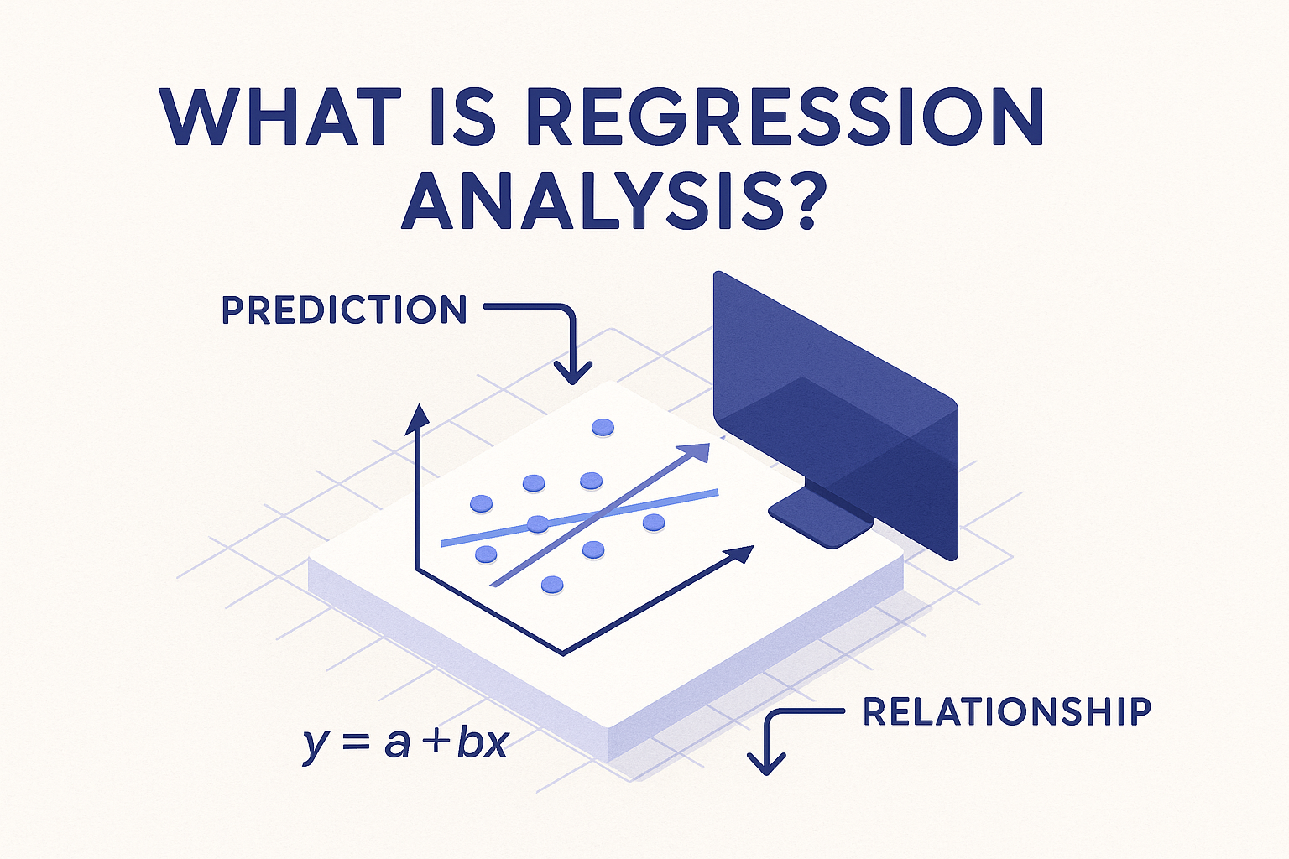
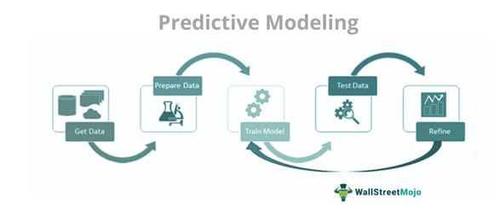
Overview
Motivation
Games can be expensive, especially with frequent purchases
There are many more successful free games as of late
Project goal
Are free games enough to fulfill players?
What do free games have to offer and how do they compete with paid games?
The goal of this project is to analyze whether free games are enough to fulfill players based on player engagement data, review statistics, and popularity metrics.
Tools used
Tableau
MySQL
Juypterlabs
Techniques used
Correlation analysis
Regression
Predictive modeling
Data cleaning and preprocessing
K clustering

Slide 3
Research Questions
What qualifies as a success for whether a free game is sufficient?
Player activity/retention
Review scores
How do genres influence success?
Certain genres may thrive in free-to-play models while others may do better as paid releases

Slide 4


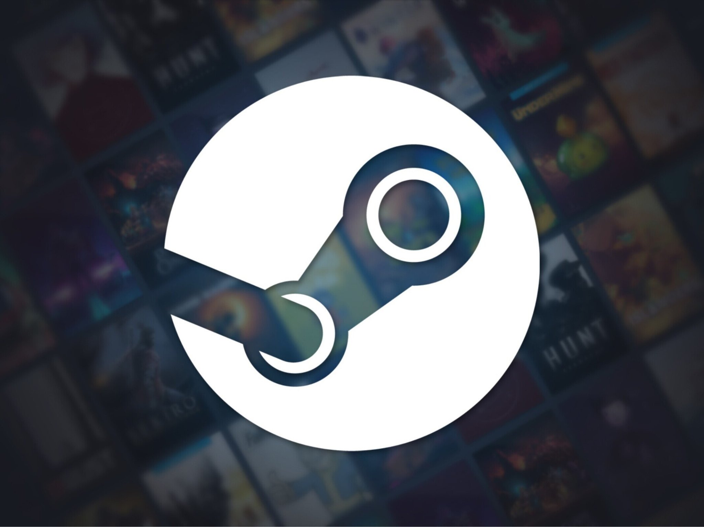

Approach
Example Free:
The Finals
Counter-Strike 2
World of Tanks
Umamusume Pretty Derby
Warframe
Apex Legends
Destiny 2
DOTA 2
Team Fortress 2
Path of Exile
Marvel Rivals
Crab Game
Overwatch 2
Quake Champions
Supervive
Example Paid:
Helldivers 2
Lethal Company
Clair Obscur: Expedition 33
Hades
Garry’s Mod
Baldur’s Gate 3
Elden Ring
Fallout 4
Red Dead Redemption 2
Cyberpunk 2077
Hollow Knight: Silksong
Monster Hunter Wilds
Black Myth: Wukong
Lord of the Rings: Gollum
Battlefield 2042
Using Kaggle we mined 110,000 games covering a wide range of genres such as shooters, RPGs, strategy, co-op, MMOs, roguelikes, open-world

Slide 5
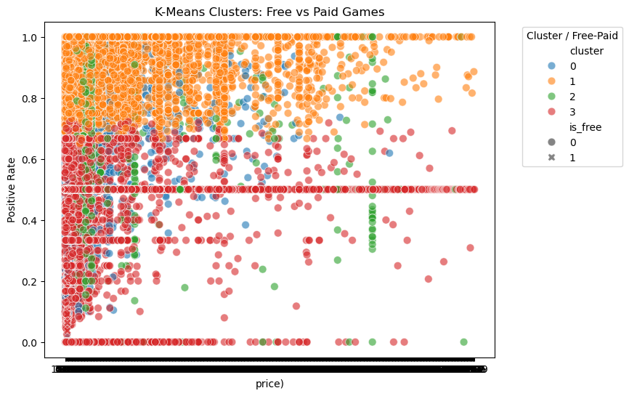
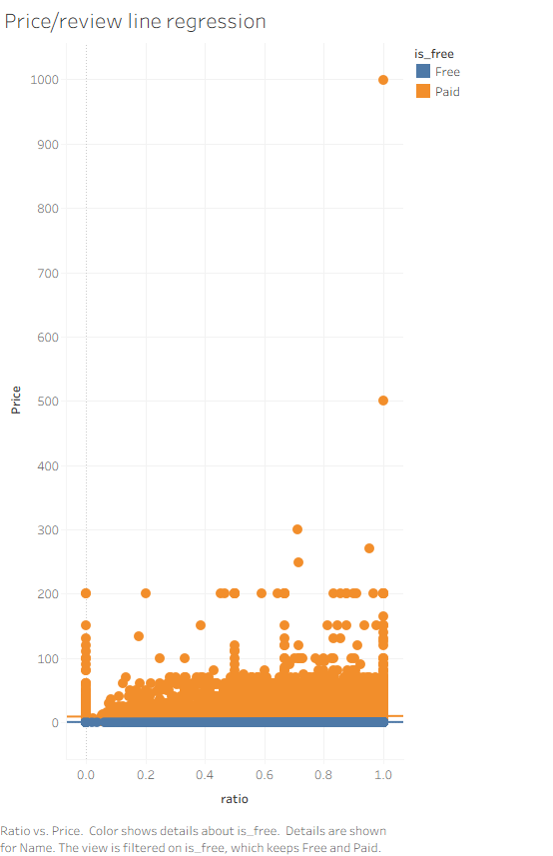
K-Means clustering Model
The analysis shows that free games can achieve high popularity despite having no cost, and some low-priced paid games behave similarly to free games in terms of user reviews. Paid games display more diversity, indicating that price alone doesn’t determine user reception.

Slide 6
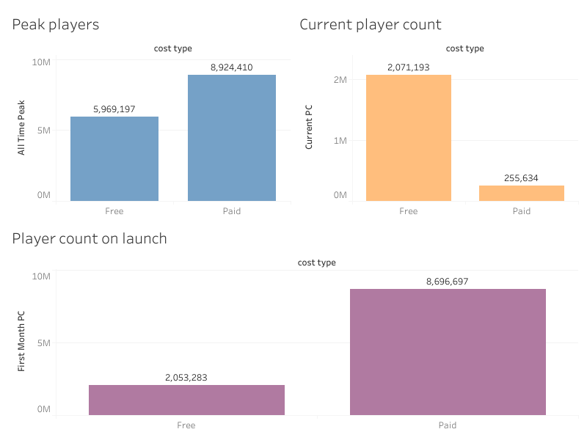
Player Count Results
These are some bar charts depicting the player count during important parts of a games life.
Based on how launch, peak, and current player counts look we can infer that while initially paid games will have a greater player count and in turn reach more people during its initial run. These tend to drop off as the game lives on and we see that free games retain their player base past their inception.

Slide 7
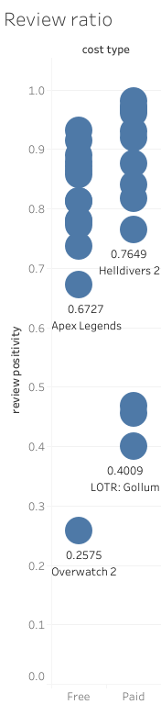
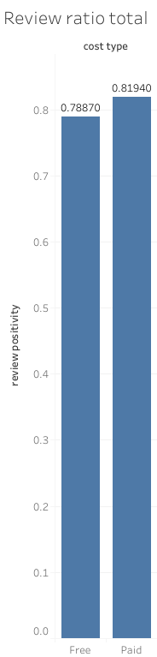
Review Results
The graph on the left depicts review sentimentality for individual games while the right tallies for every game of that type the lower scoring the worse the reviews.
Based on this we see that on average paid games are reviewed better. If we take a look at the left chart we see that paid games do have more “outliers” within that data with 3 of their 15 being rated below 0.5 compared to free games with 1 out of 15 but for the purposes of this set of data we conclude that paid games are reviewed as “better”.

Slide 8
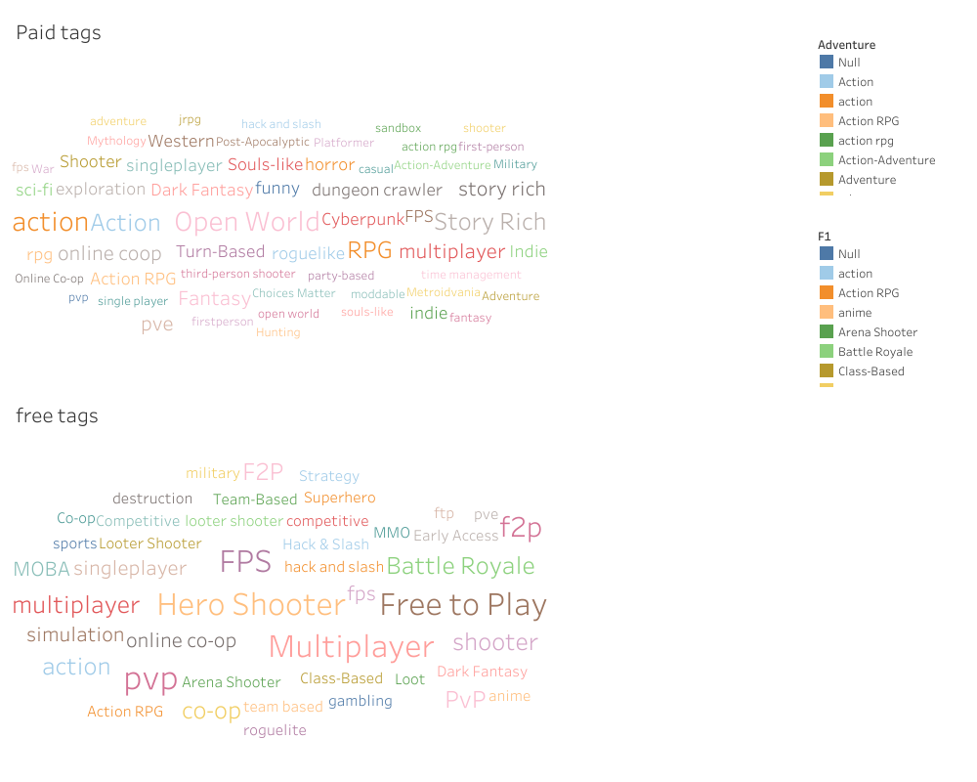
Genre Results
These word maps the tags associated with the games. The larger the word, the more times it was linked to a game from that dataset.
We can see that paid titles have a lot more diversity with its selection having many broad genres. Free games are more restricted, being dominated with action, shooter, and team based tags.

Slide 9
Conclusion
Are free games good enough?
People question whether they even have to buy games considering Steam offers many of them for free. Based on our data, free to play game titles consistently delivered equal or greater long term value compared to paid games.
Maintains a large and stable player base, while paid titles tend to decline after launch
Genre also matters more than price
For many players, free games offer comparable enjoyment and long term engagement without the upfront cost. Paying for games is often not necessary to get high value, however, paid games may offer something that free games may not.
Certain genres (FPS, MOBAs, Team Multiplayer) thrive in F2P models
Others (RPGs, Story-driven games, single-player titles) perform better as paid releases

Slide 10
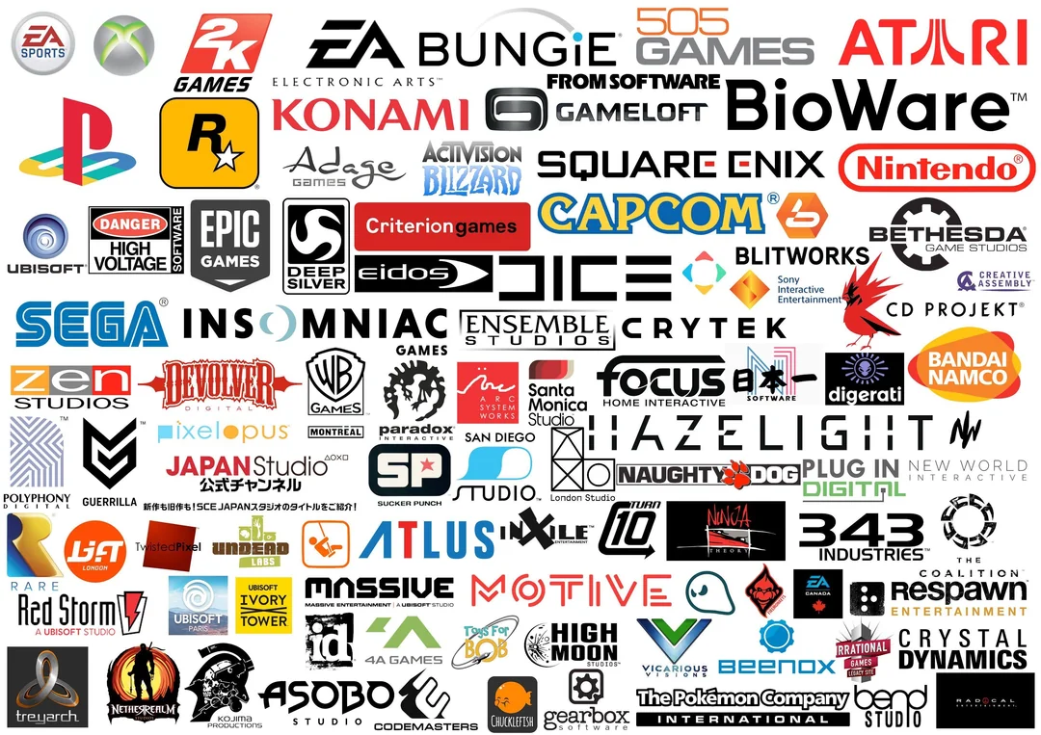
Application to Real Life
How can consumers and game developers use this data?
For consumers:
Better purchasing decisions
Discover personal high-value games
For developers and studios:
Insight on game success
Market trends/target marketing
Pricing strategies
Improve the steam platform algorithm

